Slide 1
OKHire
Professional Dating
Rhys Jones, Kian Pierce, Samer Jouhar, Kushal Chhetri, Amr Binmubarak and Andrew Thibodeau

Slide 2
Problem Statement
Overwhelming volume of job listings
Difficulty finding positions that align with a seekers skills and preferences
Traditional job search platforms lack a user-friendly interface
Lacks personalized experience that a job seeker would expect
Notes:
Problem statement
Overwhelming Volume of Job Listings:
"In today's job market, job seekers are overwhelmed with countless job listings. This abundance can be overwhelming, making it difficult for individuals to filter through and find the opportunities that truly match their career goals."
Difficulty Finding Positions that Align with Seeker's Skills and Preferences:
"One of the major challenges job seekers face is finding positions that not only suit their skill set but also align with their career preferences and aspirations. Traditional job search engines often lack the sophistication to match these nuanced needs."
Lack of User-Friendly Interface in Traditional Platforms:
"Current job search platforms often have complex interfaces that can intimidate or frustrate users, particularly those who are not tech-savvy. This complexity can deter job seekers from effectively using these platforms."
Lack of Personalized Experience:
"Traditional job platforms often treat the job search process as a one-size-fits-all solution, which fails to address individual preferences and the unique backgrounds of each job seeker."

Slide 3
Confusing Applications
Each job ad has their own expectations for completing an application
Many “high-value” jobs have lengthy and confusing application processes containing multiple steps that may last for months on end.
No chance for critical feedback from employers.
Notes:
Varied Expectations for Completing Applications:
"Each job advertisement comes with its own set of expectations for the application process. This variance can be confusing for job seekers as they navigate different requirements from one application to the next."
Lengthy and Confusing Application Processes for High-Value Jobs:
"Many high-value positions involve complex and prolonged application processes, often consisting of multiple steps that can extend for months. This can be daunting and discourage even the most qualified candidates."
Lack of Feedback from Employers:
"A common frustration in the job application process is the lack of critical feedback from employers. Many candidates never hear back, leaving them to wonder where they might have gone wrong."

Slide 4
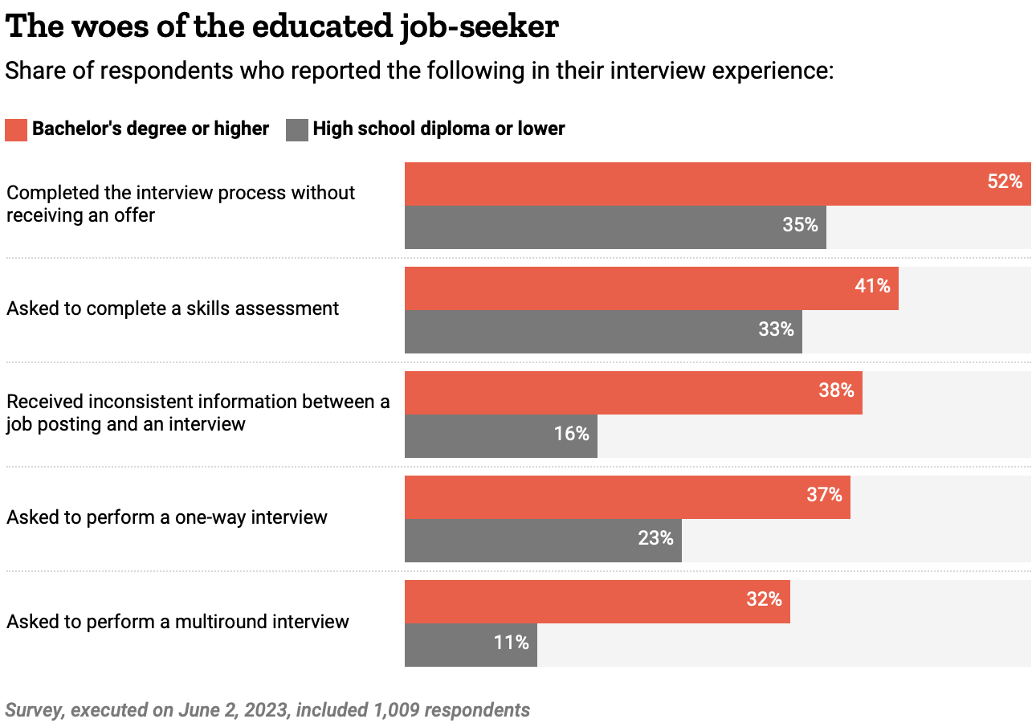
Employers are becoming more demanding
According to Time Magazine, 2023 saw an all time high for time to hire a new employee of 44 days
Ghost jobs are posted that are never filled
51% of job seekers with bachelor’s had at least 1 technical interview
two/thirds of surveyed job seekers “ghosted” after job interview.

Slide 5

What is OkHire?
Swipe-based job search application
Job seekers can easily search and “apply” jobs
Recruiters can view potential candidates
Profiles include “resume” like information
Schedule interviews
Notes:
Our proposed solution

Slide 6
How will this help?
Faster and Customizable: Our solution provides a faster, customizable, and more organized means for searching through numerous job positions and applicants.
Tinder-Inspired Matching System: Ensures applicants and recruiters only see companies and job-seekers who fit the criteria and preferences set by the user.
Efficient and Standardized: Allows recruiters to quickly scan through a large amount of applicant data and provides a one-stop location with standardized information for job-seekers, mitigating the time investment for both parties.
Notes:
How this relates to the project goal

Slide 7



Tools used
Code control with team members
Language for IOS mobile applications
Framework for Android and web applications

Slide 8
Spiral Method
Preferred method for conducting this project
Emphasizes the importance of risk assessment and mitigation
Important for a project that may seem unprofessional because of its design and interface
User-centric approach allows us to refine the product to the users’ preferences for both job seekers and employers
Flexibility and continuous improvement would allow us to add new features without much difficulty

Slide 9
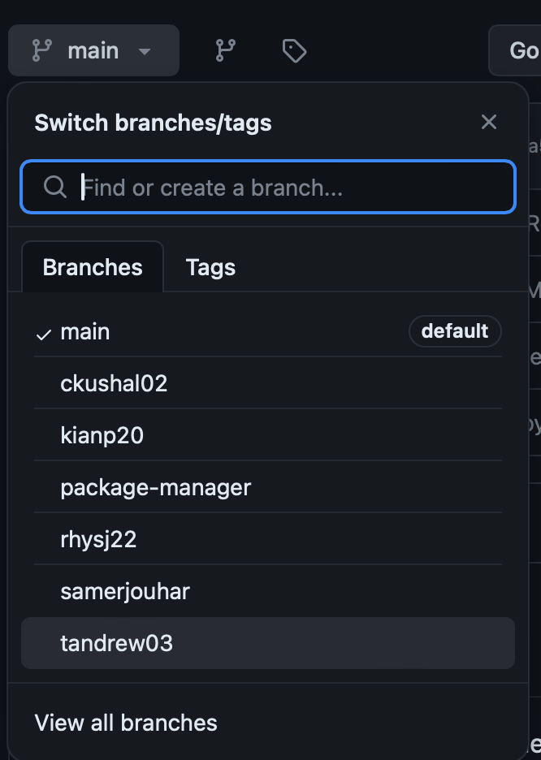

Version Control/Branch management
Github and Git was used to promote version control and allows for delegation of work
Allows for team members to make particular changes/improvements without altering the main code
Allows for the creation of new features while still running the working product.

Slide 10

Interface Design: Wireframes
Efficient way for visualizing application
Show the different views of a job seeker and employer
Does not always cover the intricacies or all of the views of an application
Does not show different views for different platforms(formatting, design, etc.)
Balsamiq used

Slide 11


Planned Deployment
Utilize AWS’ Elastic Cloud product to deploy our project
Provides Built-in security and observability
Develop a Continuous Integration/Deployment pipeline
Automates building, testing, and deployment
Jenkins
Regularly update project with new features and improved architecture
Receive regular feedback from clients to improve our product
Create a team that regularly communicates with the clientele
Scale as needed for greater client volume

Slide 12
Potential Future Work
Provide an AI tool that analyzes the employees resume to determine any potential weaknesses of the resume
Missing “hot-key” words
Missing essentials that make a resume
Qualification
Certifications
Suggestions for improvements based on other successful job seekers
Forum/”Chat room” that allows job seekers to communicate with one another to provide useful information and tips that may help one another
Upload abilities for more simplistic sign up

Slide 13
MOCK USER INTERFACE

Slide 14
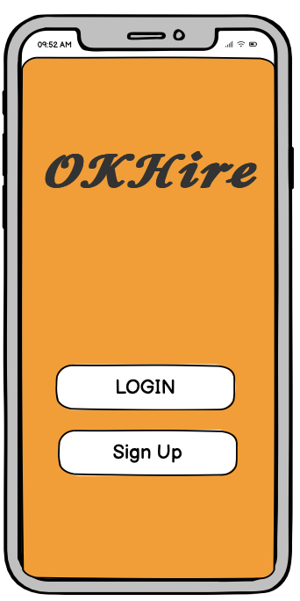
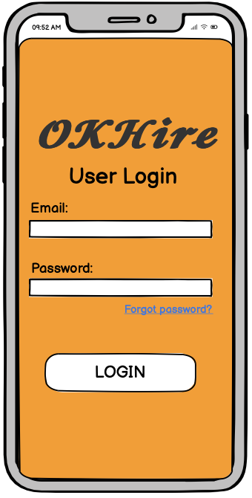
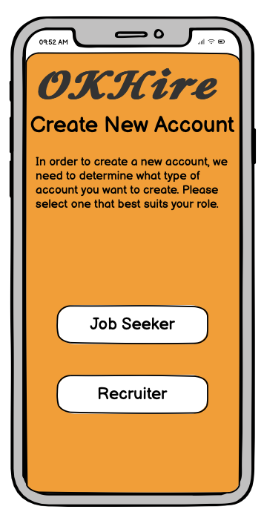

Slide 15
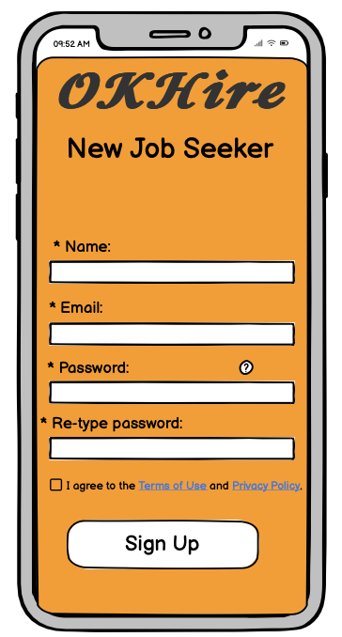
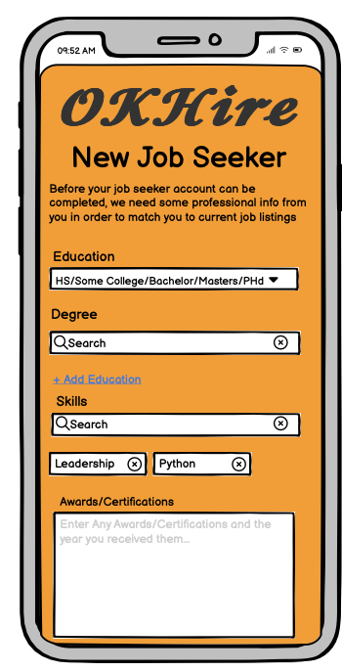
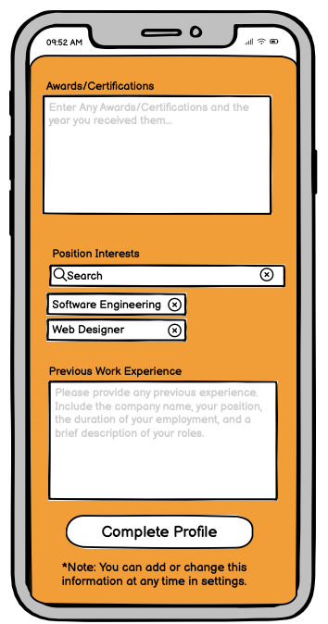
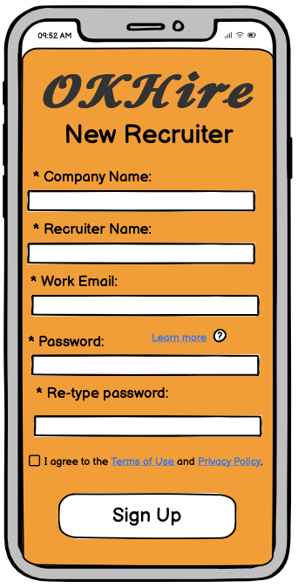

Slide 16
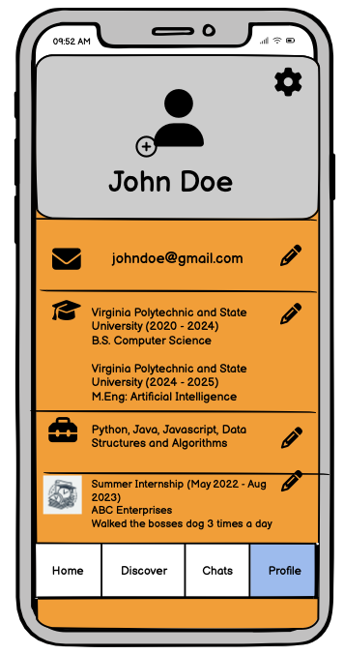
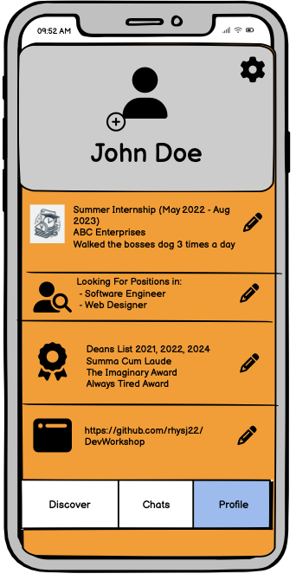
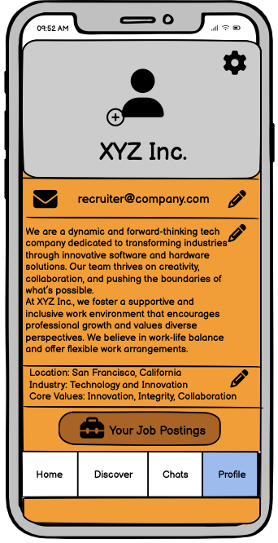
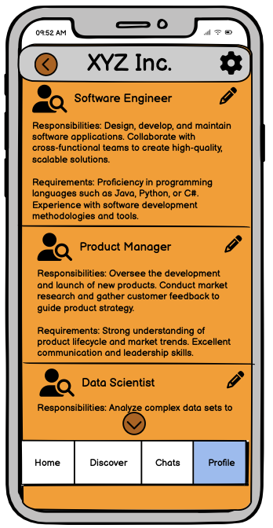

Slide 17
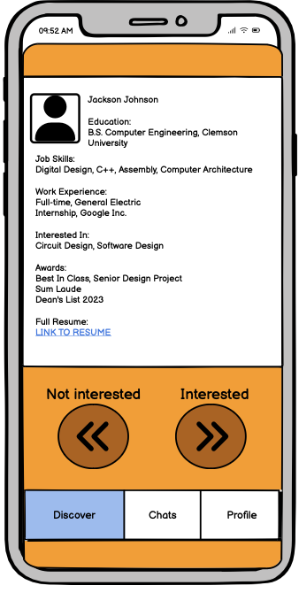
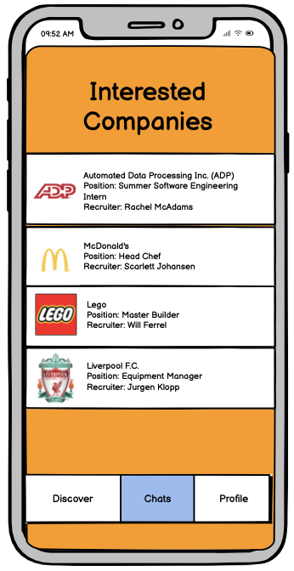
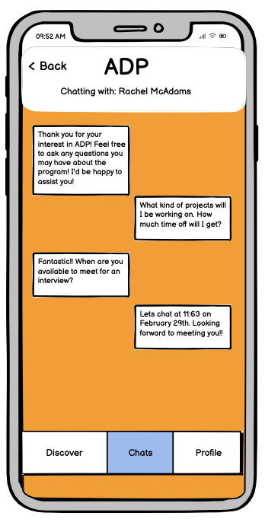

Slide 18
QUESTIONS?

